Slide 1
PYTHON
Batch 8

Slide 2
Contents
Course Overview
Course Motivation
Introduction to Python

Slide 3
Why did you choose this course?
Fundamentals of Python
Achieve a Certificate (Upon successful completion)
Develop a Digital Skill
Project Based Learning
Problem Solving Skills

Slide 4
Course Details
Course: Basic Programming with Python
60 hours (20 Lectures)
Assessment
Class attendance: 10%
Quiz: 10% [2/3]
Assignment:10% [1]
Mid-term assessment: 20% [in 9th Session]
Final Evaluation: 25%
Project: 25% [before final exam, hosted on Github]
Class Routine

Slide 5
Course Completion Criteria
Attendance: > 80%
Assessment Marks: >=60%
Digital Profiling
LinkedIn Profile Link
Github Project Link
Freelancing Profile Link (Upwork/ Fiverr/ Freelancer)

Slide 6
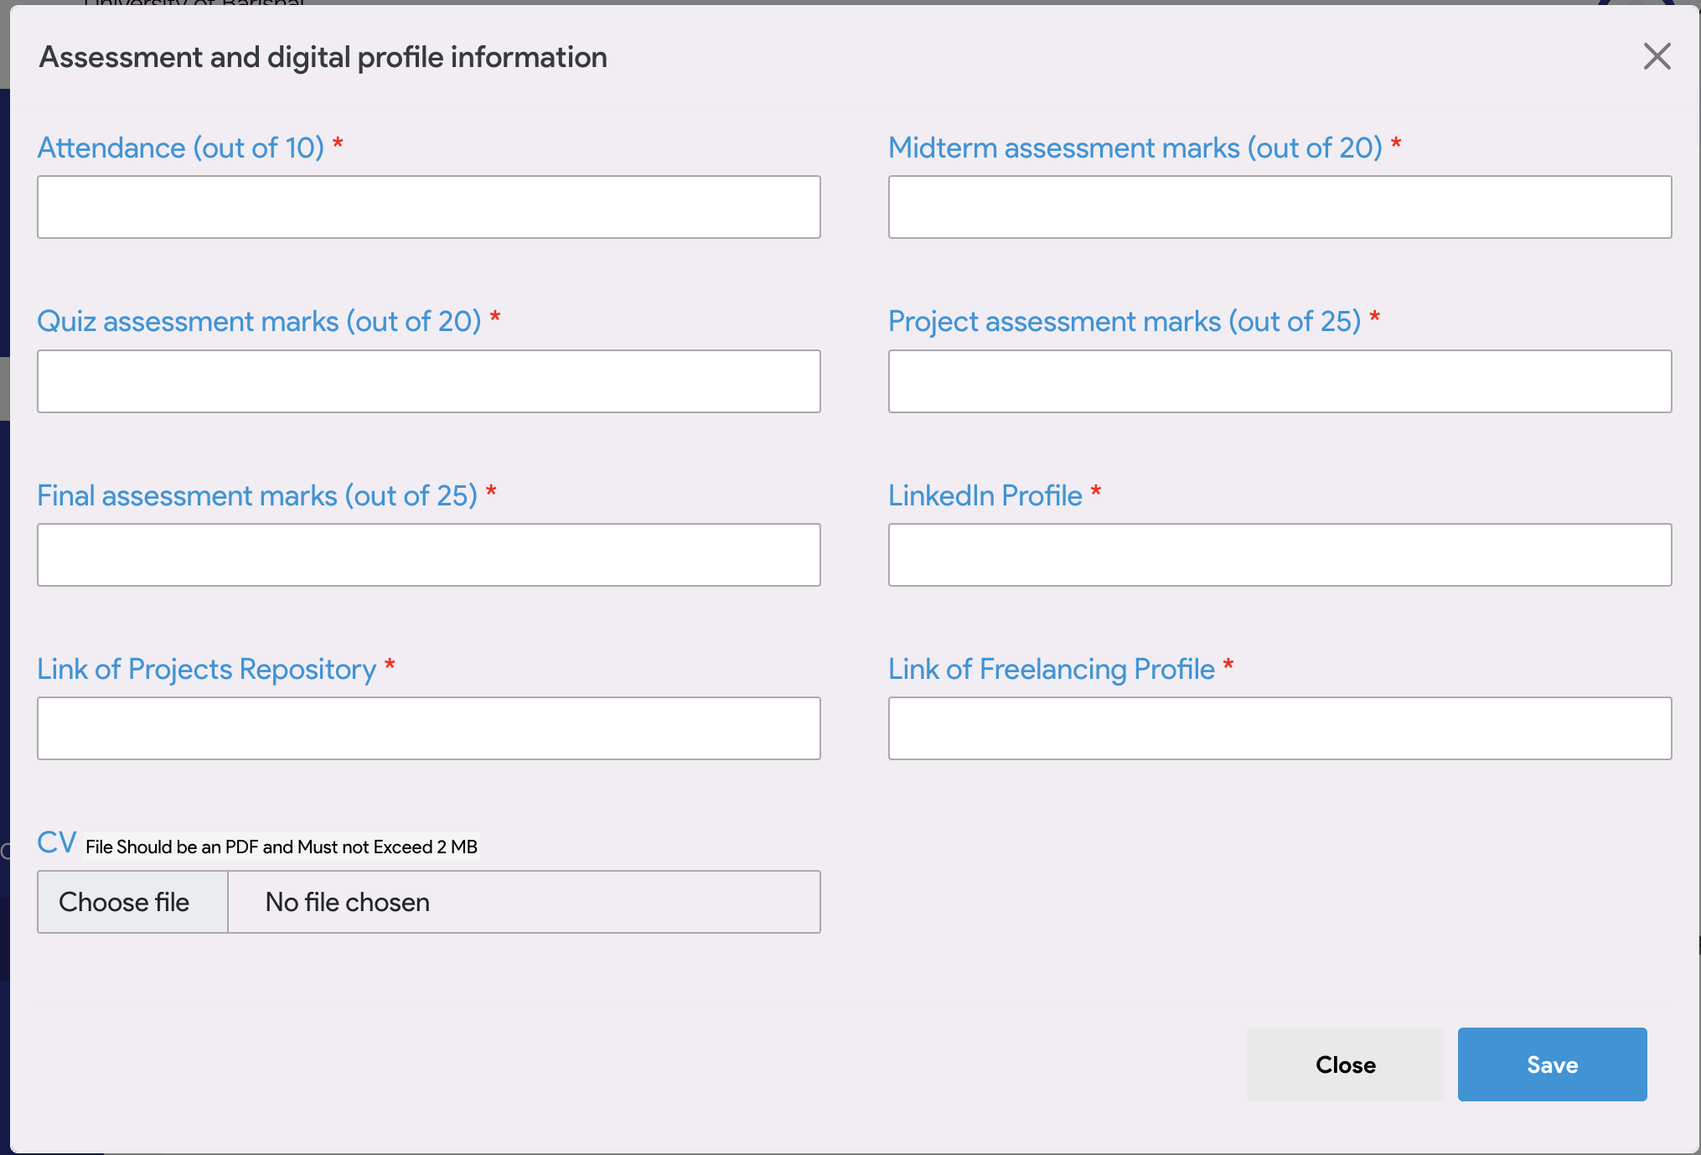

Slide 7
Course Contents
Fundamental of Python
Programming with Python
Problem Solving
Git and Github
Project Submitting in Github
Digital Profiling (LinkedIn, Github, Freelancing [Upwork, Fiverr, Frelancer])

Slide 8
Prerequisite to Develop
Basic Computer Operations
Programming Skills (Not Mandatory)

Slide 9
Computer Fundamentals
File and Folder Management
File Extensions
Typing
Editors
Browsers
Keyboard shortcuts

Slide 10
Terms to know
Python programming
Programming
Algorithm & Flowchart
Digital Skills
Data Science
Artificial Intelligence (AI), Machine Learning (ML)
Applications of Python

Slide 11
References
Tutorial: https://www.w3schools.com/html/default.asp
Resources: https://github.com/samsuddoha/Python8-P4

